Slide 1
LBBDr User Group
Session 1 – An Introduction to R
Presented by: Michael Sinclair

Slide 2

Session Outline
History of R
R Studio IDE & compiler
Data Structures and variable types
Practical session

Slide 3

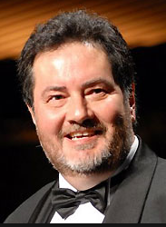
History of R
Created by Robert Gentleman and Ross Ihaka early 90s while working together at the University of Auckland, New Zealand

Slide 4

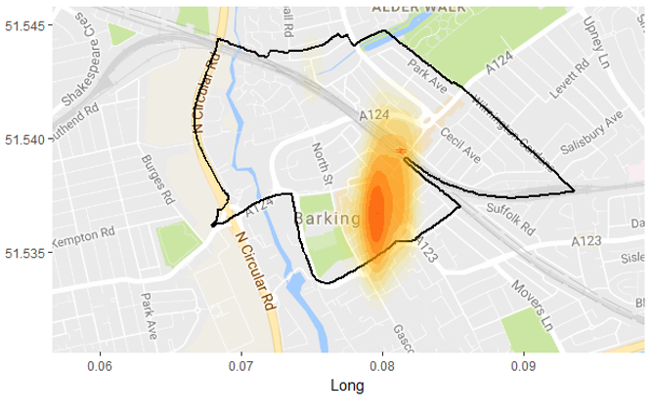
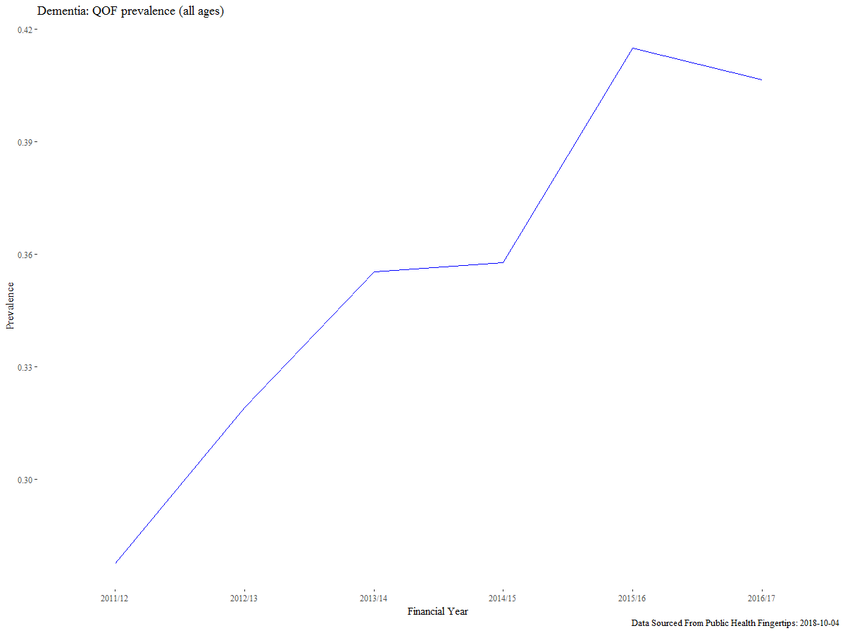
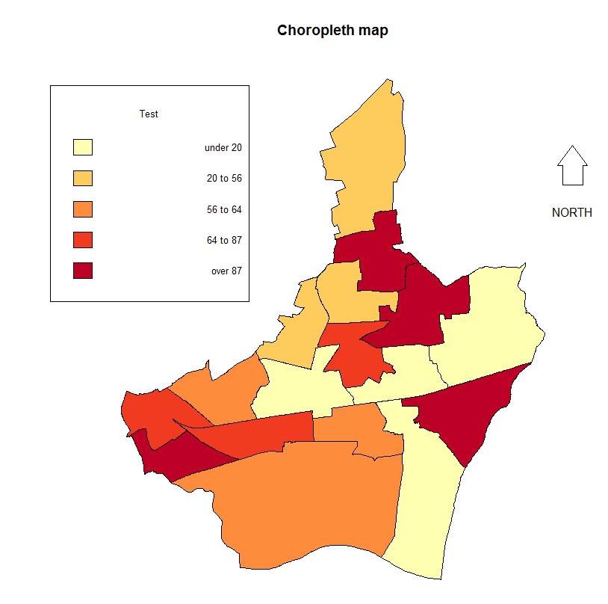
Why Use R
Notes:
Dementia QOF prevalence
Twitter ‘Social Care’
Choropleth map
Hotspot (density) mapping

Slide 5

IDE
RStudio is an integrated development environment (IDE) for R

Slide 6


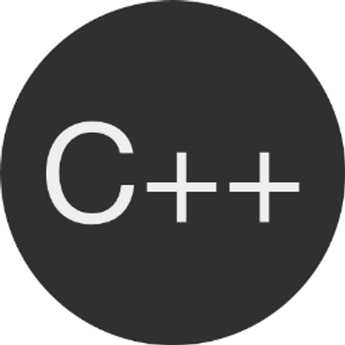
IDE
Interpreter (computing)
From Wikipedia, the free Encyclopedia
In computer science, an interpreter is a computer program that directly executes, i.e. performs, instructions written in a programming or scripting language, without previously compiling them into a machine language program. An interpreter generally uses one of the following strategies for program execution:
Parse the source code and perform its behaviour directly;
Translate source code into some efficient intermediate representation and immediately execute this;
Explicitly execute stored precompiled code made by a compiler which is part of the interpreter system.

Slide 7
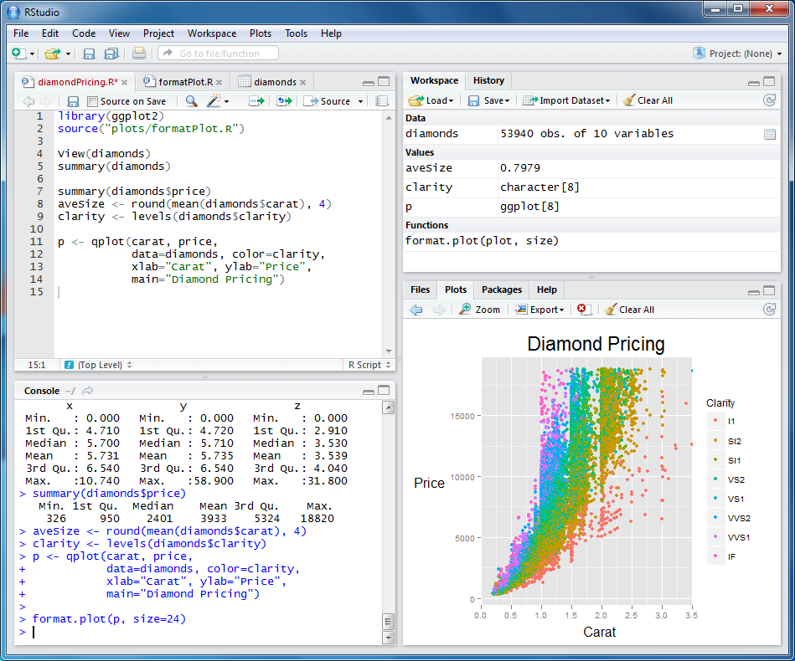
Code editor
Workspace
R Console
Plots

Slide 8
Data types
Data Type | Example
Logical | TRUE, FALSE
Numeric | 12.3, 5, 104.2
Integer | 1,5,9,102
Character | ‘a’, “hello”, ‘15 Longbridge Road’
Factors | ‘Male’, ‘Monday’, ‘August’, ‘COPD’
Date Time | 2017-01-13 (yyyy-mm-dd)
Conceptually, factors are variables in R which take on a limited number of different values; such variables are often referred to as categorical variables

Slide 9

R-objects
Vectors - When you want to create vector with more than one element
Lists - A list is an R-object which can contain many different types of elements inside it like vectors, functions and even another list inside it
Matrices - A matrix is a two-dimensional rectangular data set. It can be created using a vector input to the matrix function
Arrays - While matrices are confined to two dimensions, arrays can be of any number of dimensions. The array function takes an attribute which creates the required number of dimension
Data Frames - Data frames are tabular data objects. Unlike a matrix in data frames each column can contain different modes of data. The first column can be numeric while the second column can be character and third column can be logical. It is a list of vectors of equal length

Slide 10
#comments
When writing code use comments to make it more readable and to help understanding when sharing
#introduction to R
#this is a comment
#comments will be ignored

Slide 11
Warning
R is case sensitive for commands and variable names
weekday <- c(“Monday”, “Tuesday”)
Weekday <- c(“Wednesday”, “Thursday”)
Will create two different variables named weekday and Weekday
Also commands will not be recognised if they are misspelt including case!

Slide 12
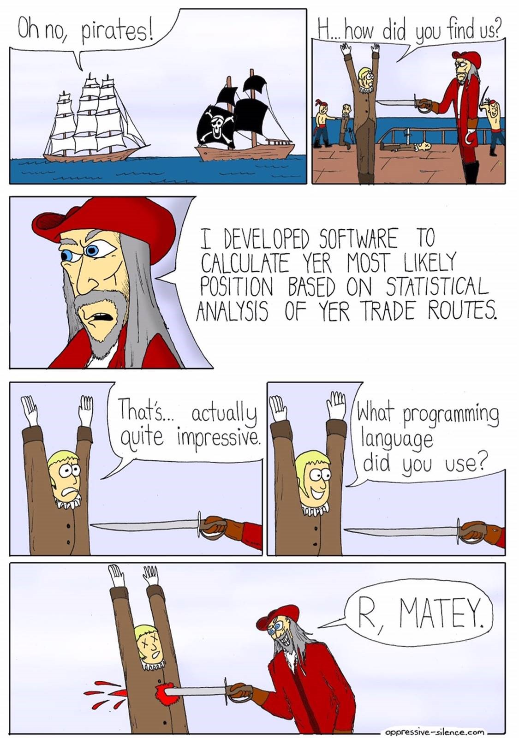
Practical session

Slide 13
//dsfin/corpcom/LBBDR/TNG/Session 1

Slide 14
Future Sessions

Slide 15









Additional Resources
www.r-tutor.com
www.coursera.org
www.datacamp.com
www.r-bloggers.com
http://tryr.codeschool.com
www.rstudio.com/online-learning
www.londonr.org

